Slide 1

PRWATECH
Share Ideas, Start Something Good.
Corporate Learning Partner

Slide 2
Who We Are?
PRWATech is India’s leading and largest training provider for Big Data and Hadoop Corporate training programs. We have expanded our domain to all the technologies and Programming Languages
We are a highly skilled team of Solution managers and Software Engineers working together in order understand the requirements and provide the most efficient and economical business offering under any circumstances.
Mission Statement
Working together with client, we still strive to provide the highest learning opportunities with cost efficient modules. We aim to create responsible, independent individuals who have skills to grow & aspire to learn to build their career.

Slide 3
The SEEKHO Advantage
Synergized Training with Hands on Sessions
Service with
Quality
Self Paced and Customized Courses
Access to 5000+ expert led Courses
Employee Certification at Module Completion
Use project files and quizzes to practice while you learn

Slide 4
PRWATECH: Value Offering
All Domains: Unlimited Access
Expert Instructors
Self Paced and Customizable
Select what you would like your
employees to learn from our
Extensive Subscription Library
Learn from industry experts who
are passionate about teaching
Learn at your ease at your
Available timings and with loads of
Customization options

Slide 5
Services and Offerings

Slide 6
Our Product Portfolio
Recruitment Solutions
Self-Paced Online Training
Highly efficient trained candidates, custom suited as per your requirements. Pre-checks and testing involved in rigorous hiring process
VI
I
Learner can control the amount of material they consume as well as the duration of time they need to learn the new information properly
Instructor-Led Live,
Online Training
LMS
Highly Interactive Learning Sessions with the help of Video tools and self paced courses
V
II
Structured Knowledge Sharing sessions available over the web with expert assistance and round clock support
Webinar Sessions
On-Premise Classroom Training
Structured Knowledge Sharing sessions available over the web through pre-registration
IV
III
Train your employees with exclusive instructor led batches, with hands on training and live projects

Slide 7
Course Library
AI and Machine Learning
Azure Administrator
Tableau Training and Certification
AWS Architect Certification
Python Spark Certification
AI and Machine Learning
BIG Data Hadoop Certification
Cybersecurity
Data Analyst Masters
Python Certification
Google Cloud Certification
R Decision Tree Modeling
Data Science Elementary
Apache Kafka Certification
Advanced Predictive Modeling
Cloud Architect
Microsoft BI
IoT Certification
… and many more!

Slide 8
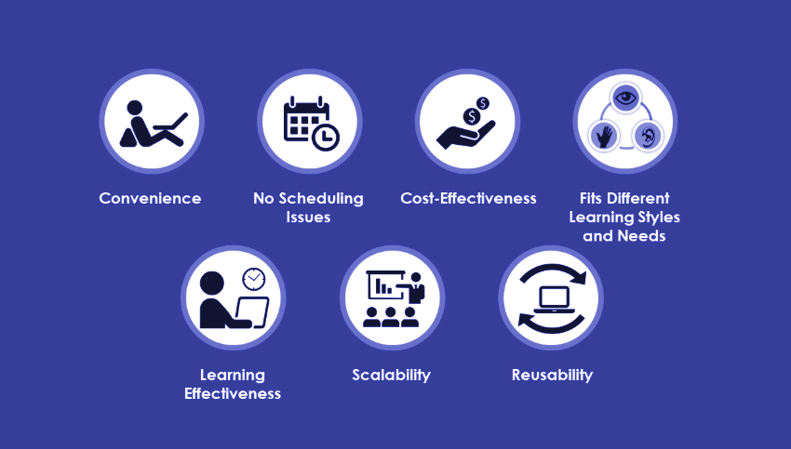
Self Paced Courses for Corporate: Why?

Slide 9
Convenience
Fits Different Learning Styles and Needs
Self-paced learning gives learners the convenience of learning anytime and anywhere. This gives them an opportunity to balance work and training. They need not fret on not being able to attend scheduled training programs because of work commitments. With self-paced learning, they can choose their time and whether they want to learn at work or at home. Another advantage is, this training can be fit into the employee’s schedule based on their personal preferences or job responsibilities. This convenience encourages employees to finish the course, which significantly reduces dropout rates
We know that different people have different learning styles. While some may prefer to go through the content multiple times to understand it, others can grasp the meaning after one reading. Some learners require more time to complete a course, while others may not. When learning and comprehension times vary, quick learners may have to wait for others to complete the course while slow learners will have to struggle to keep pace with others. Self-paced learning will suit all types of learners because everyone learns at their own pace
Learning Effectiveness
No Scheduling Issues
Learners tend to learn better when they learn at their own pace. This is because they allocate the learning time based on the difficulty of the study material. This improves the retention of difficult subjects because they will devote more time to it and focus their energies on learning
While self-paced learning offers convenience to learners, it also eliminates scheduling issues for the organization. Scheduling is an issue when you have to train a large number of people by gathering them at the same time. Scheduling issues, rescheduling, or cancellations do not occur with self-paced learning, as the training manager only needs to launch a training program and set a date for its completion
Scalability and Reusability
Self-paced learning provides scalability because you can train as many people as you want, with modest incremental costs. Once you have developed the curriculum and training material, which could be your only investment, you can spread the training among as many employees as you choose. When the training is designed for courses that you will be using again and again (think of training on compliance policies or standard training manuals), self-paced learning is a wise choice. Using it for permanent content removes the need to have live facilitators and related scheduling concerns
Cost-Effectiveness
Virtual training involves accrued costs of paying the instructor and for the technology. Self-paced learning does not involve these costs, the only investment is in developing the course. So, it is highly cost-effective

Slide 10
Customizable Offerings
Tailor-Made Courses
24x7 Support
Flexible Engagement Model Tailor-Made for Your Needs
Round-the-Clock Support by In-House Subject-Matter Experts
Wisdom Analytics
Certifications
Customized Dashboard to Visualize Training Progress
Industry Recognized Certification to Add Value to Your Workforce
Hands-on Cloud Sessions
Projects
Hands-On Experience on Projects Pre-Configured to Get Started Immediately
Right Mix of Theoretical and Practical Training for Real World Industry Problems

Slide 11
Learning Management System
Online self paced learning courses for technology enthusiasts from all technological domains. The courses are self paced and provide intensive study and practice material to facilitate learning without hurdles
How this Works?
Course Catalogue
Choose your Bundle
Administration Credentials
Select from over 5000+ Courses including AI, Big Data and Machine Learning
Customize your product bundle and avail maximum courses at discounted rates
Each company will get administrative control to mange employee induction for training
Roll out Courses
Employee Engagement
Self Paced Learning
Courses to be rolled out for Employees
Round the Clock assistance from trained professionals and industry experts
Employees get to Schedule their learning with self customization options and online learning material
Self Assessment
Certification
Tailor-Made Projects
Online and Offline Assessment with review and feedback
Top Rated Industry Certifications for Premium Courses
Customized projects to make every employee a unicorn employee

Slide 12










Existing Partner Companies

Slide 13



Testimonials
Learning at each step PrwaTech has been striving to help individual business by providing the accurate technology to harness the best of their efforts. Understanding the problem is far more important than solving the problem.
Nilesh Pandey
Entrepreneur, PRWATech Foundation
Co- Founder, Ziffytech Digital HealthCare Pvt. Ltd.
We provide the most optimized and customizable applications for business not only on a large scale but also on the smaller scale to help and support the upcoming entrepreneurs. In the ever developing field of technology we provide a strong, versatile foundation to support IT companies in the areas of BIG DATA and HADOOP Mainframes.
Priyanshu Verma
Founder, PRWATech Ltd.

Slide 14
Media Releases

Slide 15

Press Covers
Times of India
20.05.2014
https://https://timesofindia.indiatimes.com/defaultinterstitial.cms
The Hindustan Times
17.08.2015
https://www.hindustantimes.com/
The Hindu
20.10.2016
http://www.thehindu.com/opinion/editorial/

Slide 16
Partnership Avenues

Slide 17
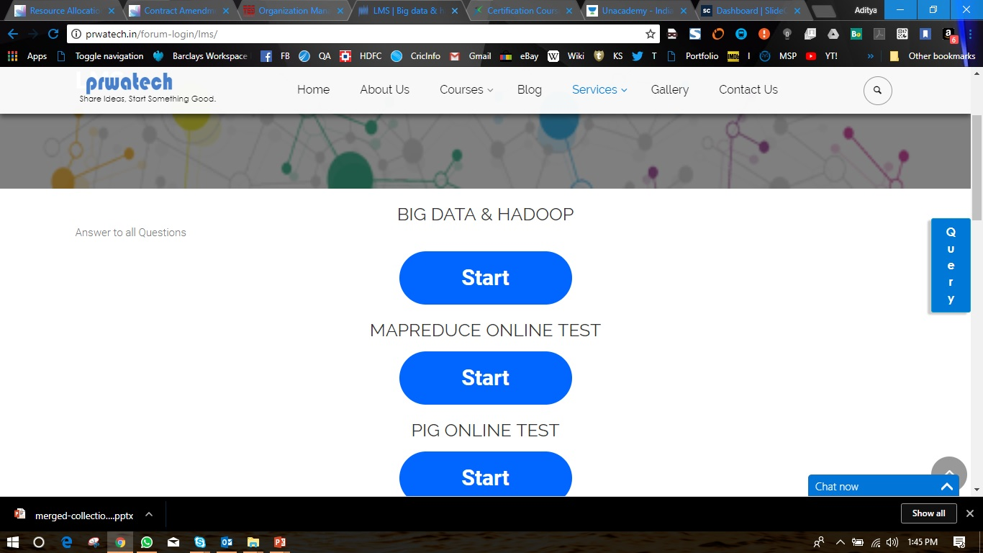

Online Learning
Wide Academic Base
Highly specialized courses to drive your success. Your tremendous career in Data
Science and Data Engineering starts here. Wide range of Courses from Java, C++, Python, Hadoop to AI and Machine Learning. All Courses available with Certification and online support
Online Assistance
Live Classes
Programming Courses
Covering all the programming languages across all domains and functions
Round the clock support from industry professionals
Webinars and Online Learning Sessions

Slide 18
Classroom Training
Multiple Classroom Training Centers
We have multiple training centers across the country and all are equipped with high end digital learning facilities and experienced Faculties
Weekend Classes
Webinars
Weekend classes at your College/ University
Available with PRWATech Faculty
We conduct weekly webinars for
Students and professionals across the globe.
Free access would be given with partnership
Monthly Classes
On Center Training
Monthly Visits by PRWATech Faculty for
Doubt Clearing Sessions also available
Students visiting PRWATech Centers and getting the required
Guidance when needed

Slide 19
Recruitment Assistance
LMS
Screening
Profiling
&
Applications
Interview
& Training
Job Referrals
Students under the Partnership program get registered on LMS Portal
Screening Tests to be given by Students under different domains and Technologies
Further Assistance based on Screening Score
Screening Test Results and Scores shared with PRWATech Partner Companies
Companies make the selection based on the profile and connect for further job Application
Selected Candidates get Interview specific training with PRWATech Professionals
Training for Students who couldn’t make the cut for Applications
The Candidate/ Student can keep on giving tests on LMS and upgrade their scores
The LMS Scoresheet is accessible to Partner companies who pick candidates based on scores

Slide 20
Partnership Plans
 | Online Learning | Self Paced | Self Paced Pro | PRWA Premium
Online Classroom Training
Online Assistance and Support with Practice Courses
Self Paced Courses
Self Paced with 24x7 Support
Live Project Training

Slide 21
Contact
Priyanshu Verma | +91 8951603761
+91 8951603761
+91 7045155846
BTM
No 14, 29th Main Road, 2st Cross
BTM Layout, 1st Stage, Behind Axa Building,
Land Mark : Vijaya Bank ATM,
Bangalore – 560 068
Karnataka, INDIA
www.prwatech.in
info@prwatech.in

Slide 22

Start with a Partnership Now!

